Slide 1
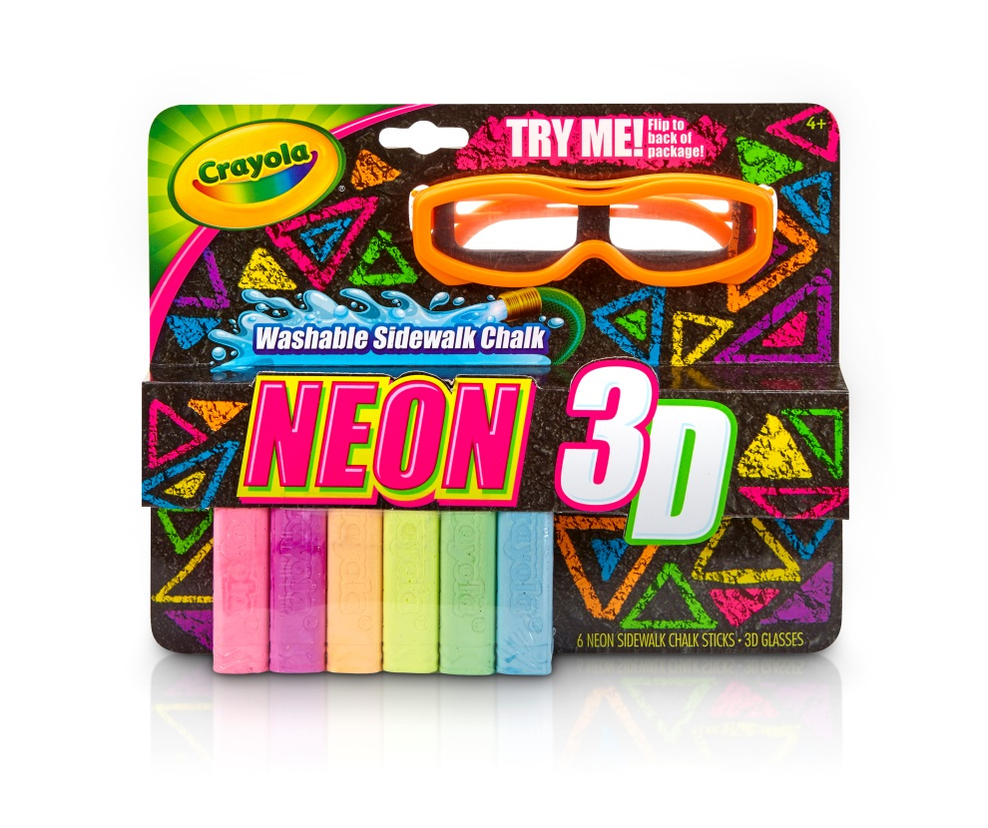
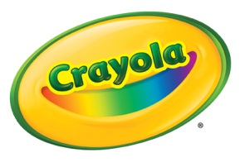
Crayola® Neon 3D Chalk Set
Crayola 3D Neon Chalk provides kids a new way to experience color outside and creates a new outdoor coloring activity.
Benefits
Ultra bright neon chalk with fluorescent pigments are even brighter in sunshine.
Durable plastic 3D glasses feature special lenses that make chalk colors “float” above the ground at different levels.
Crayola sidewalk chalk is anti-roll and washable. Just spray away with a hose, or just let it fade with the rain.
Includes neon colors: Shocking Pink, Laser Lemon, Electric Lime, Extreme Blue, Atomic Tangerine, and Super Purple.
Contents
6 Washable Neon Chalk Sticks
1 Pair Neon 3D Plastic Glasses
4+
SRP: $4.99
Available Now!

