Slide 1
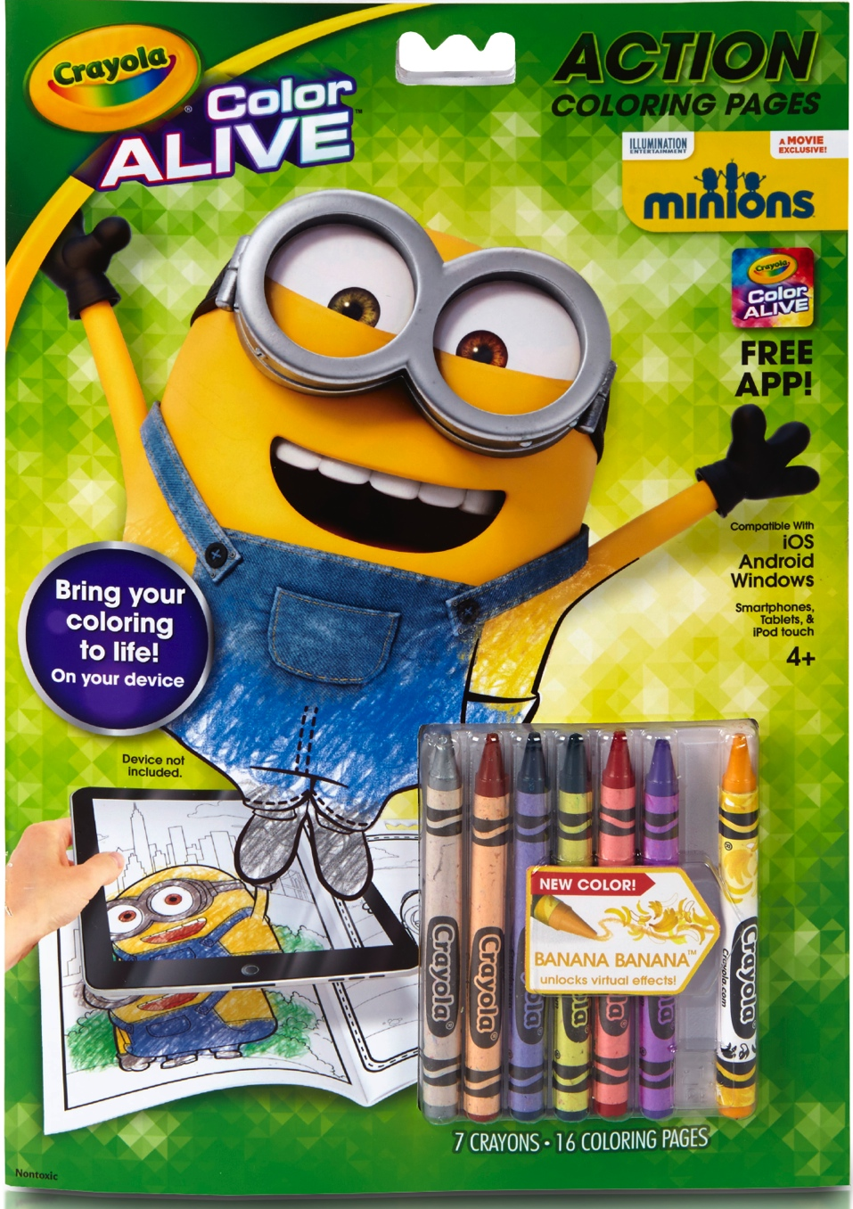
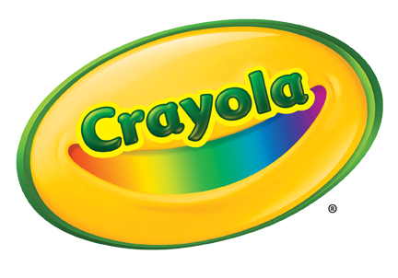
Color Alive Minions
Benefits
Free iOS/Android app brings your coloring pages to life
New color “Banana Bonanza” unlocks special virtual sparkle effects
Unique interactive experiences on every page
New colors in each book work across all Color Alive books
Features
Color Alive offers a whole new way of coloring and includes an on and offline experience!
The free app is compatible with iOS and Android smartphones and tablets, and iPod Touch.
Includes:
Coloring Book w/ 16 coloring pages
7 Crayola crayons including new “Banana Bonanza” with special virtual color effects
4+
SRP: $5.99
Available Now!

